Slide 1
Dynamics of Tax LAW Abuse Cases Across France : A Comparative Annual Study
By : Sabrina, kenza, mYRIAM

Slide 2
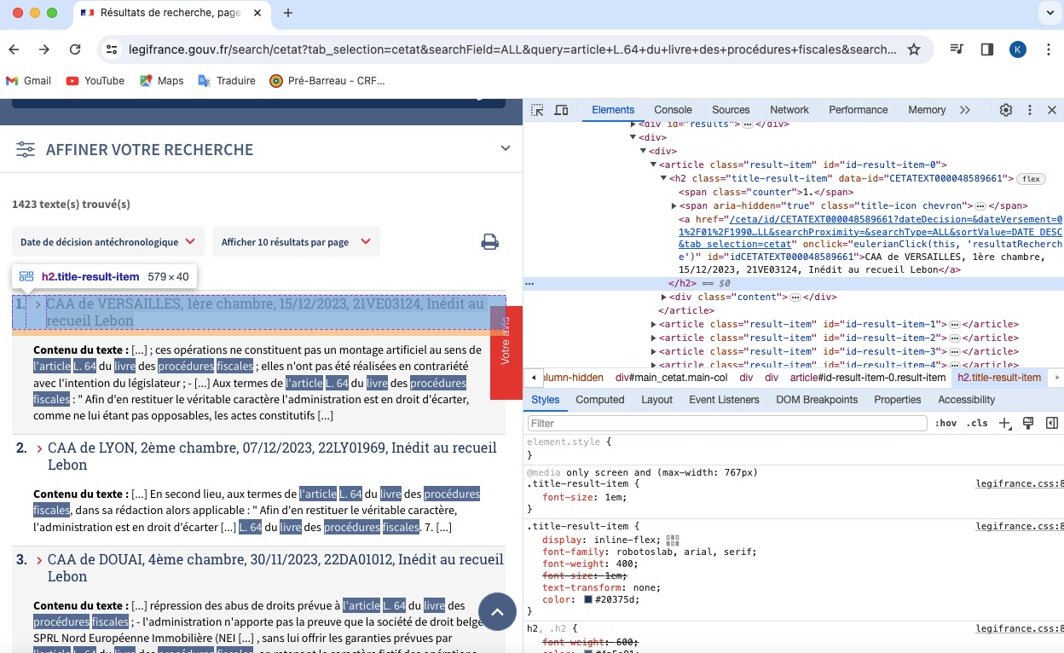
How We Initiated the Coding…
We conducted a thorough search on Legifrance, specifically within the administrative jurisprudence section, for all the Administrative Court of Appeal rulings pertaining to article L.64 of the French Tax Procedures Handbook (LPF). We then meticulously inspected the results page to identify the specific element that contained the necessary information for each ruling we required

Slide 3
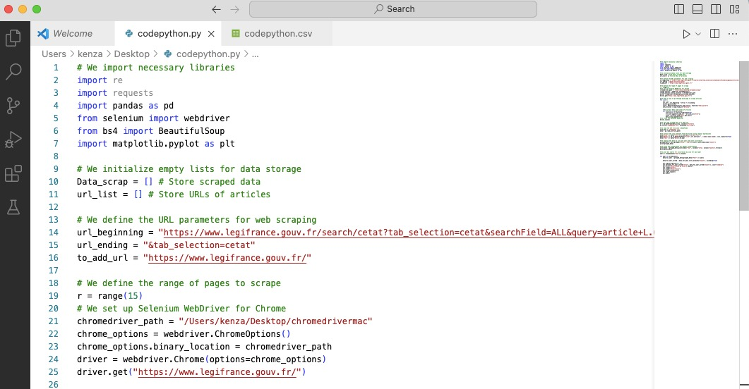
Step 1 : importing Libraries
Step 2 : Initializing Empty List
Step 3 : Defining URL parameters
Defining the range of pages to scrape
Step 4 : Setting up WebDriver

Slide 4
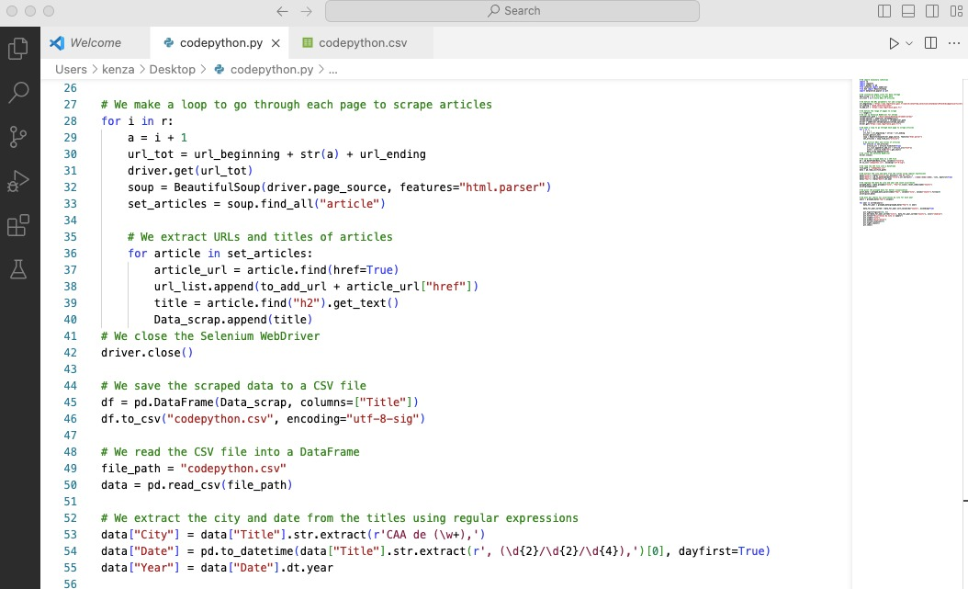
⁠Step 5 : Scraping Articles
exctract the url and title of each article
Step 6 : Closing WebDriver
⁠Step 7 : Saving Scraped Data to CSV file
Step 8 : Reading Data from CSV file
⁠Step 9 : Extracting city and date

Slide 5
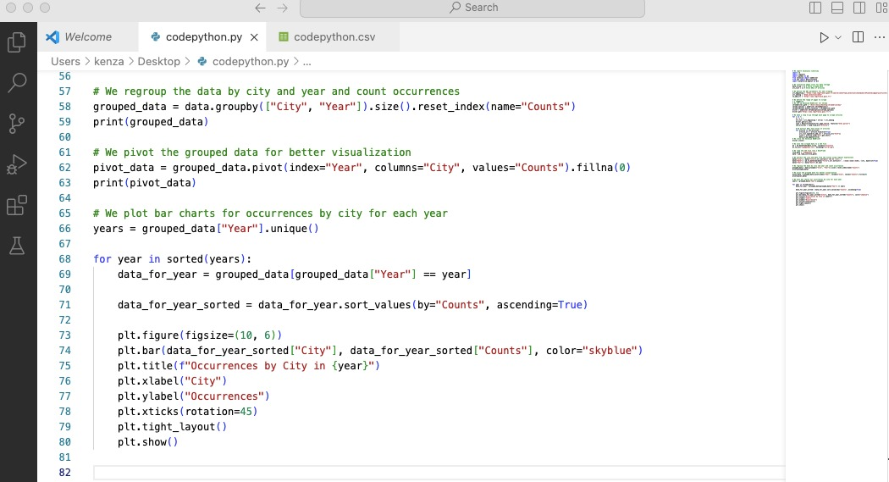
⁠Step 10 : Grouping Data
⁠Step 11 : Pivoting Data
⁠Step 12 : Plotting Bar Charts

Slide 6
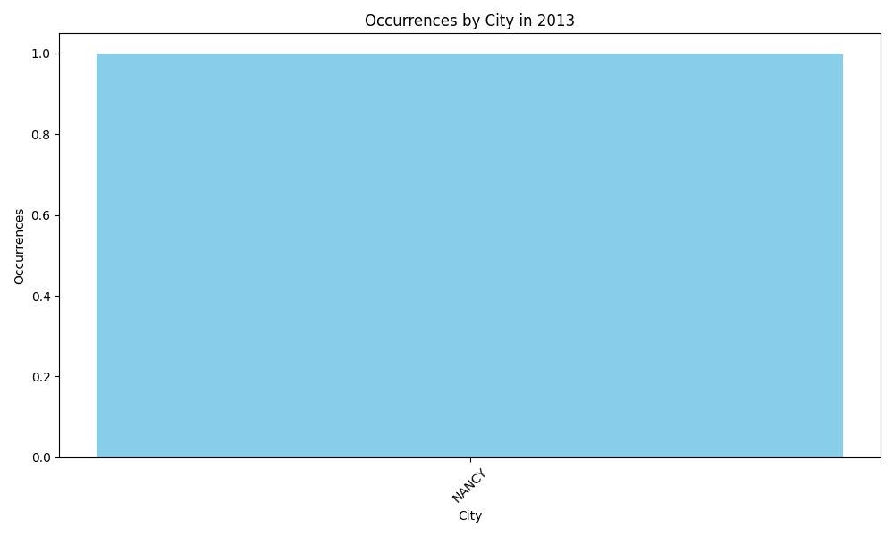
RESULTs
2013

Slide 7
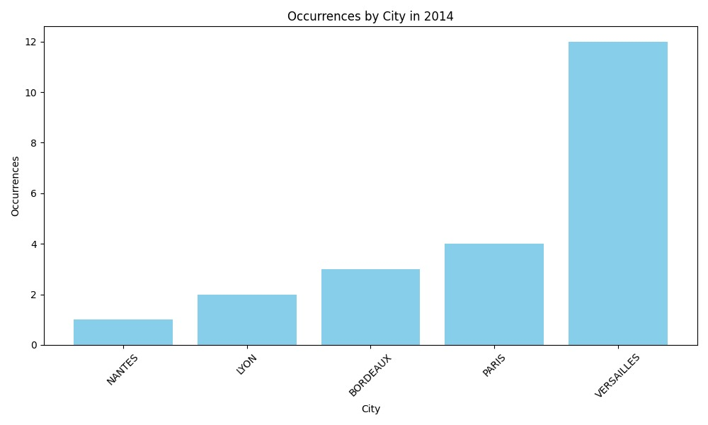
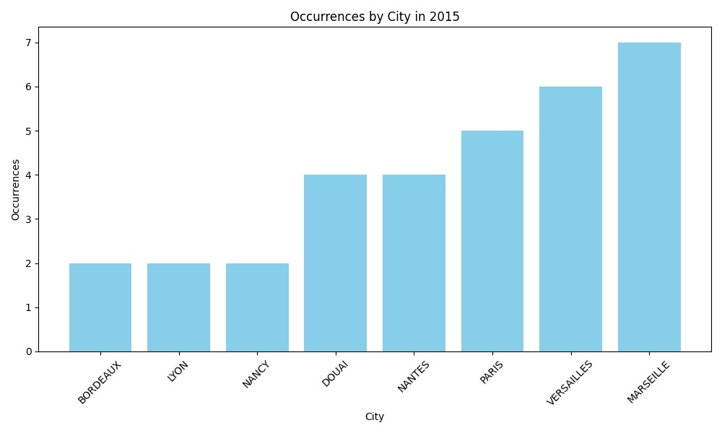
2014
2015

Slide 8
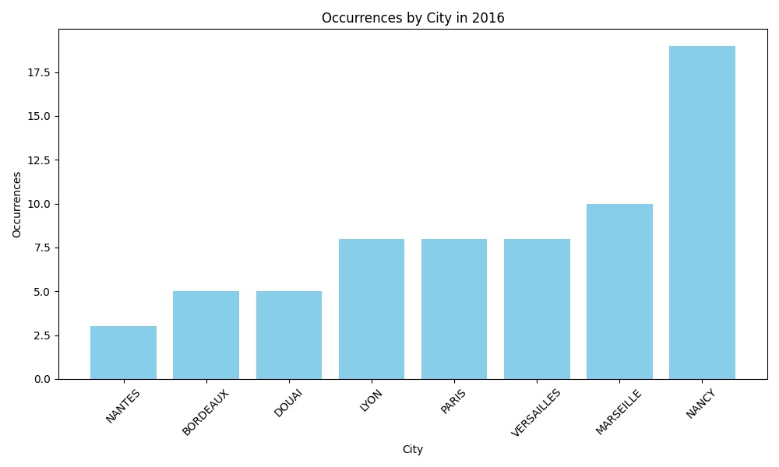
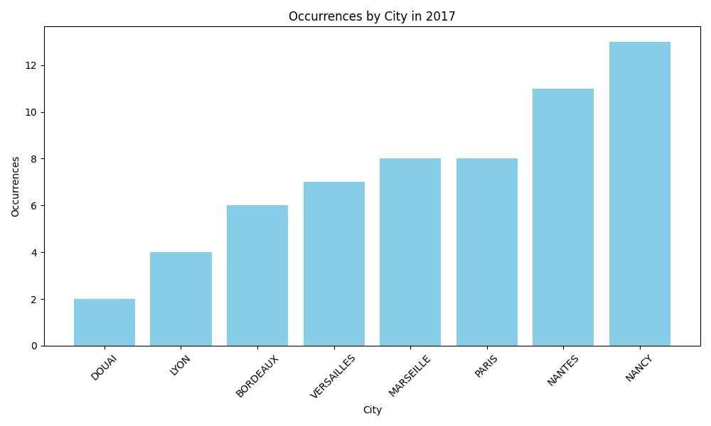
2016
2016
2017

Slide 9
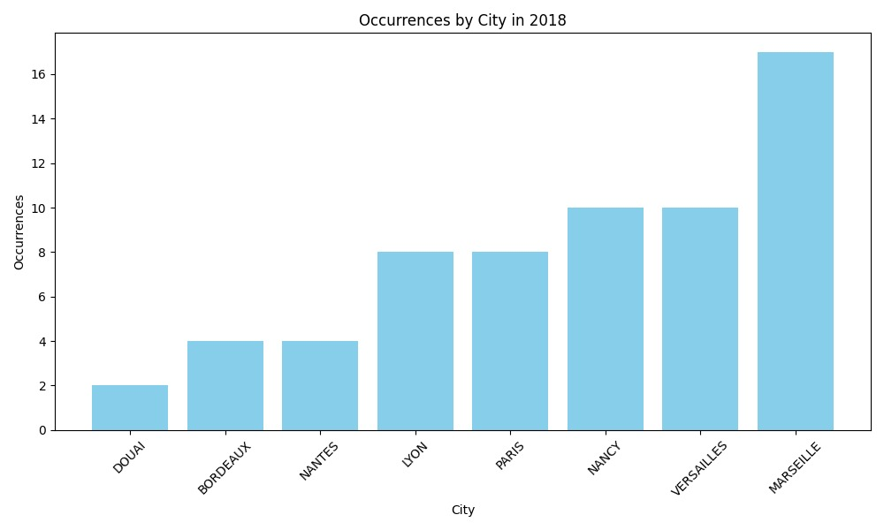
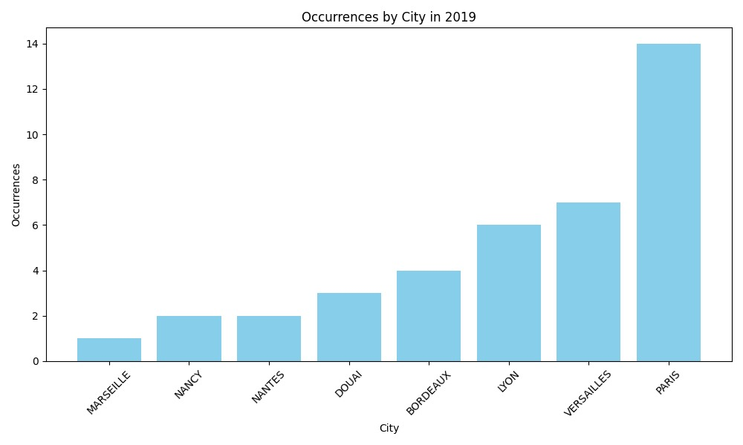
2018
2019

Slide 10
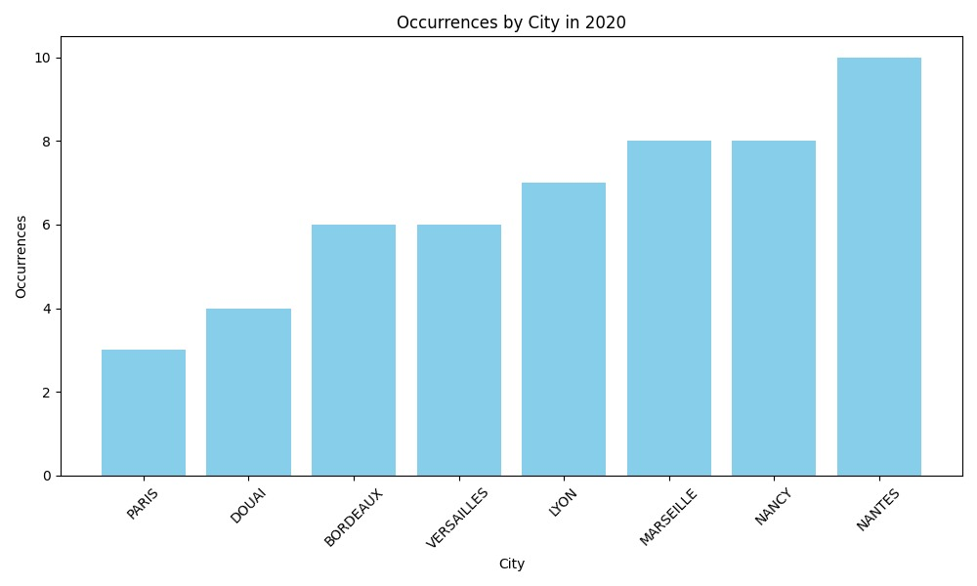
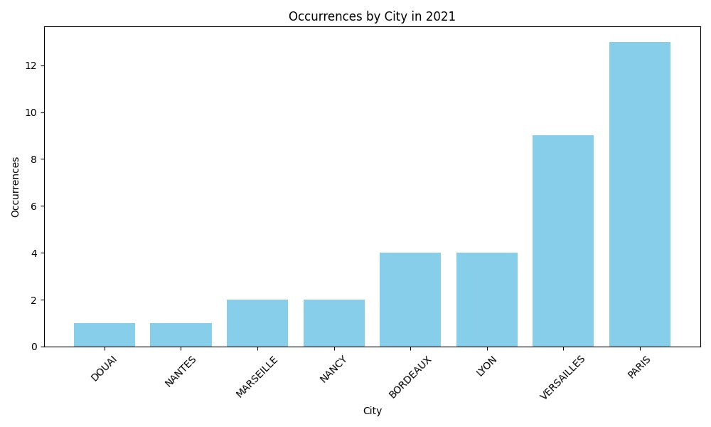
2020
2021

Slide 11
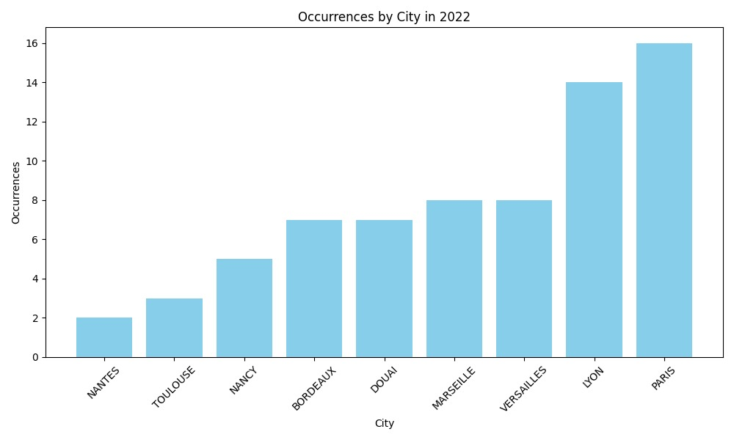
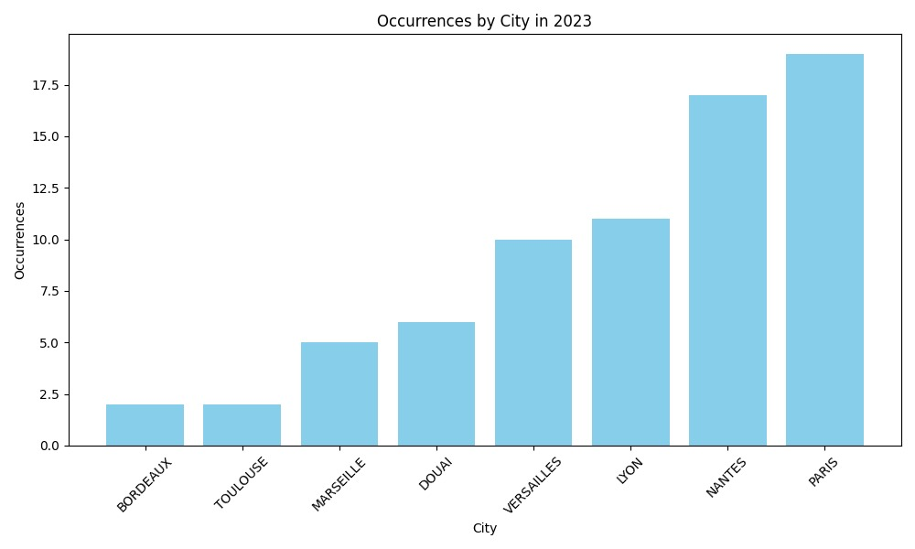
2022
2023

Slide 12

Thank you for your attention during our presentation !
And a special thanks to our prefessor who helped us until the end !

